Slide 1
State Management
Prepared for Vth semester DDU-CE students 2019-20 WDDN
Apurva A Mehta

Slide 2
*
Aishwarya Rai Bachchan | P.V.Sindhu | Chitra Ramkrishna | Muthayya Vanitha and Ritu Karidhal
Actress | Badminton Player | Former CEO at NSE | Chandrayaan-2

Slide 3
Introduction
Stateless web server
Requirement to maintain data per user.
Login details
Browsing data
Passing of data from one page to another page.
Notes:
A professional ASP.NET site might look like a continuously running application. When the page is delivered, the connection is severed, and the web server discards all the page objects from memory. By the time the user receives a page, the web page code has already stopped running, and there’s no information left in the web server’s memory.

Slide 4
State Management Techniques
Client
Server
I am Cody. I am shopping for books. I have two titles in my cart worth of 340 INR
I am session 856
Client
Server
Session 856 is Cody. Cody is shopping for books. Cody has two titles in cart worth of 340 INR

Slide 5
Client Side
Techniques
View State
Control State
Hidden Fields
Cookies
Query Strings
Better Scalability
Support for multiple web servers
Notes:
View State
Cross Page Posting
Query String
Session State
Cookies
Better scalability
With server-side state management, each client that connects to the
web server consumes memory on that server. If a website has hundreds (or thousands)
of simultaneous users, the memory consumed by storing state management information
can become a limiting factor. Pushing this burden to the clients removes that potential
bottleneck and frees the server to use its resources to serve more requests.
■ Support for multiple web servers With client-side state management, you can distribute
incoming requests across multiple web servers (or a web farm). In this scenario,
each client provides all the information any web server needs to process a request. With
server-side state management, if a client switches servers in the middle of the session, the
new server does not necessarily have access to the client’s state information (because it is
stored on a different server). You can use multiple servers with server-side state management,
but you need either intelligent load balancing (to always forward requests from
a client to the same server) or centralized state management (where state is stored in a
central database to which all web servers have access).

Slide 6
View State
Method to preserve the Value of the Page and Controls between round trips
Data is not stored by server
Page level state management
Used to retrieve old values after page postback
Page.ViewState
__ViewState
Notes:
View State is the method to preserve the Value of the Page and Controls between round trips.
It is a Page-Level State Management technique.
It can be used to retrieve old values after post back of the page.
The Page.ViewState property provides a dictionary object for retaining values between
multiple requests for the same page. This object is of the type StateBag. When an ASP.NET
page is processed, the current state of the page and its controls is hashed into a string and
saved in the page as an HTML hidden field called __ViewState. If the data is too long for a
single field (as specified in the Page.MaxPageStateFieldLength property), ASP.NET performs
view state chunking to split it across multiple hidden fields. The following code sample demonstrates
how view state adds data as a hidden form field within a webpage’s HTML.
<input type="hidden" name="__VIEWSTATE" id="__VIEWSTATE"
value="/wEPDwULLTEzNjkxMzkwNjRkZAVvqsMGC6PVDmbCxBlPkLVKNahk" />
Notice that the view state values are hashed, compressed, and encoded for Unicode
implementations. This provides better optimization and more security than just simple
HTML hidden fields.

Slide 7
Cont.
Demo
D:\Personal\WDDN\C# Codes 2019-20\ClientSide_ViewState\ViewState_Demo
No server resources are required
Passed during every postback as hidden elements
Add few Kbytes to the page
Passed as plain text
Tightly bound to a single page
Notes:
view state doesn't require any server resources for its operation.
It is passed to the client during every postback as an hidden element. Since it is added with every page, it adds few Kbytes to the page. This effects the loading of the page in the client.
Main problem with ViewState is, since it is passed as plain text to the client. Anybody can tamper this value, because of this you shouldn't store any important data in the ViewState.
One of the most significant limitations with view state is that it’s tightly bound to a specific page. If the user navigates to another page, this information is lost.

Slide 8
Query Strings
https://www.google.com/search? q=tom+hanks+sully
Limited to simple Strings with URL legal characters
Clearly visible to the user and to anyone else who cares to eavesdrop on the Internet
Limit on size of Query Strings
Submit page by HTTP GET command
Query string data is included in bookmarks
Notes:
Another common approach is to pass information by using a query string in the URL. This approach is commonly found in search engines.
http://www.google.ca/search?q=organic+gardening
The query string is the portion of the URL after the question mark.
Information is limited to simple strings, which must contain URL-legal characters.
Information is clearly visible to the user and to anyone else who cares to eavesdrop on the Internet.
The enterprising user might decide to modify the query string and supply new values, which your program won’t expect and can’t protect against.
Many browsers impose a limit on the length of a URL (usually from 1 KB to 2 KB). Therefore, you can’t place a large amount of information in the query string and still be assured of compatibility with most browsers.

Slide 9
Cont.
Should always encode query string
Server.UrlEncode(), Server.HtmlEncode()
Retrieve on server
Page.Request.QueryString
Simple but limited way to maintain state information between pages
Demo
D:\Personal\WDDN\C# Codes 2019-20\ClientSide_ViewState\Query-Strings_Demo
Notes:
Some special characters are not allowed in URL or having different meaning of that.
Like ‘+’ is used to indicate white space between the words.
What if string itself contains ‘+’ sign???
Always parse query string in encoded way.
ASP.Net can automatically decode it while receiving it.

Slide 10
Cookies
Small files created in
Web browser’s memory temporary
Client’s hard drive permanent
Reliable and Flexible
Long term storage
Used by any page
Retained between visits
Client can delete cookies
Do not solve issue of user moving from one device to another
Notes:
Cookies provide another way to store information for later use. Cookies are small files that are created in the web browser’s memory (if they’re temporary) or on the client’s hard drive (if they’re permanent).
One advantage of cookies is that they work transparently, without the user being aware that information needs to be stored. They also can be easily used by any page in your application and even be retained between visits, which allows for truly long-term storage.

Slide 11
Cont.
using System.Net;
Response.Cookies.Add()
Page.Response
Cookies
HttpCookieCollection
HttpCookie
Name, Value
How to delete from server?
Demo
D:\Personal\WDDN\C# Codes 2019-20\ClientSide_ViewState\Cookie_Demo
Notes:
MCTS EXAM Book

Slide 12
Server Side
Techniques
Application State
Session State
Better security
More involved and Large State
Reduced bandwidth
Global State
Notes:
Storing information on the server has the following advantages:
■ Better security
Unless you digitally sign information stored on a client, users can change
client-side state management information. Therefore, you should never use client-side
state management to store confidential information such as passwords, access levels,
or authentication status.
Reduced bandwidth
If you store large amounts of state management information,
sending that information back and forth to the client can increase bandwidth utilization
and page load times, especially when clients have low upstream bandwidth (as is
common with home and wireless networks). Instead, you should store large amounts
of state management data (say, more than 1 KB) on the server.

Slide 13
Session State
User specific state that is stored by server
Available only to pages accessed by a single user
ASP.NET tracks each session by using a unique 120-bit identifier
Client, SessionId, Server, Session
SessionId
Cookies, URL
System.Web.SessionState.HttpSessionState
Notes:
ASP.NET tracks each session by using a unique 120-bit identifier. ASP.NET uses a proprietary algorithm to generate this value, thereby guaranteeing that the number is unique and it’s random enough that a malicious user can’t reverse-engineer.
When the client presents the session ID, ASP.NET looks up the corresponding session, retrieves the objects you stored previously, and places them into a special collection so they can be accessed in your code
For this system to work, the client must present the appropriate session ID with each request. You can accomplish this in two ways:
Using Cookies
Using URL
You can interact with session state by using the System.Web.SessionState.HttpSessionState class, which is provided in an ASP.NET web page as the built-in Session object.

Slide 14
Cont.
Loss of session state
user closes and restarts the browser.
user accesses the same page through a different browser window
session times out due to inactivity.
Session.Abandon()
Notes:
If the user closes and restarts the browser.
If the user accesses the same page through a different browser window
If the session times out due to inactivity.
If your web page code ends the session by calling the Session.Abandon() method

Slide 15
Cont.
HttpSessionState Members
Count
IsCookieless
Keys
Mode
SessionID
Timeout
Abandon()
Clear()
Web.config
Notes:
You configure session state through the web.config file for your current application. The configuration file allows you to set advanced options.

Slide 16
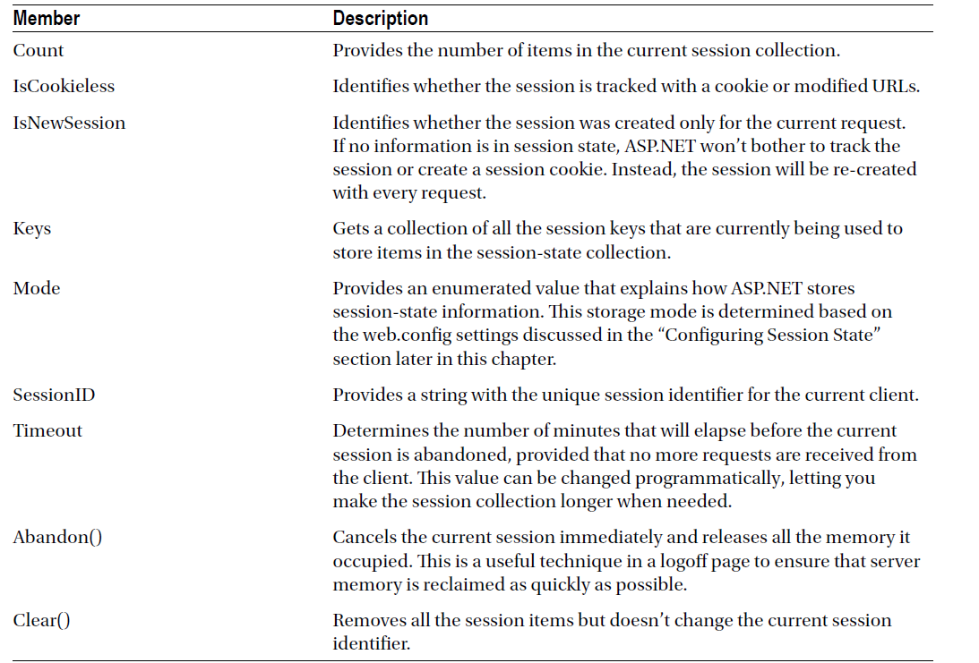

Slide 17
Cookieless
cookieless="true“
The session id is part of URL and is sent back and forth between the client and web server, with every request and response.
The web browser uses the session-id from the URL, to identify request has come from the same user or a different user.
For cookieless session to work correctly relative URL must be used in the application when redirecting users to different web forms.
Demo
D:\Personal\WDDN\C# Codes 2019-20\ServerSide\SessionState_Cookieless
Notes:
You configure session state through the web.config file for your current application. The configuration file allows you to set advanced options.

Slide 18
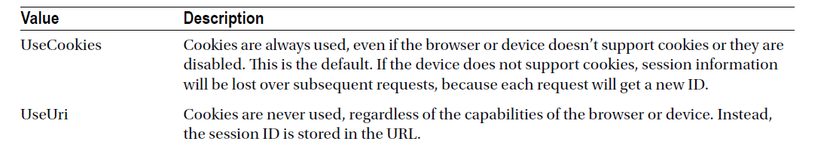
Cookieless

Slide 19
Session Mode
InProc (inside process)
Session state variables are stored on web server memory inside asp.net worker process
Easy to implement; mode="InProc“
Perform best, as session state memory is kept on the web server
Suitable for web application hosted on a single web server
Objects can be added w/o serialization
Notes:
InProc: InProc is the default mode, and it makes the most sense for small websites. It instructs information to be stored in the same process as the ASP.NET worker threads, which provides the best performance but the least durability. If you restart your server, the state information will be lost.
Web Garden: Web App deployed on a server with multiple processors
Web Farm: Web app deployed with multiple server
Show asp net worker process in task manager
Objects can be added w/o serialization: Complex Objects like Customer, Emp… No need of serializing

Slide 20
Cont.
InProc
Session state data is lost, when the worker process or application pool is recycled
Not suitable for web farms and web gardens
Scalability could be an issue
Demo
D:\Personal\WDDN\C# Codes 2019-20\ServerSide\SessionState_Demo2

Slide 21
Session Mode
StateServer
Session state variables are stored in a process, asp.net state service
Start asp.net state service manually
Can be present on a web server or a dedicated machine
ASP.NET worker process independent
Survives worker process restarts
Can be used with web farm and web garden
Offers more scalability than InProc
Notes:
StateServer : With this setting, ASP.NET will use a separate Windows service for state management. This service runs on the same web server, but it’s outside the main ASP.NET process, which gives it a basic level of protection if the ASP. NET process needs to be restarted.
ASP.NET state service: Windows-Run-services.msc-ASP.NET state service

Slide 22
Cont.
StateServer is slower than InProc
Complex objects needed to serialized and deserialized
State server on dedicated machine, if it goes down/ restarts all session variable will be lost
Single point of failure
Demo
D:\Personal\WDDN\C# Codes 2019-20\ServerSide\SessionState_StateServer

Slide 23
Session Mode
SQLServer
Session state variables are stored in SQLServer database
Most reliable
Can be used with web farms and web gardens
Most scalable
Slowest
Complex objects needs to be serialized and deserialized
Notes:
This setting instructs ASP.NET to use an SQL Server database to store session information, as identified by the sqlConnectionString attribute. This is the most resilient state store but also the slowest by far. To use this method of state management, you’ll need to have a server with SQL Server installed.

Slide 24
SessionState: Mode
Off-Disables session state for the entire application
InProc
StateServer
SQLServer
Custom-Build your own Session State provider

Slide 25
Cross Page Posting
ViewState
Tightly bound to a single page
Cross Page Posting
Extends the postback
User data from one page to another page
PostBackURL
Page.PreviousPage
FindControl()
Notes:
One of the most significant limitations with view state is that it’s tightly bound to a specific page. If the user navigates to another page, this information is lost.
A cross-page postback is a technique that extends the postback mechanism you’ve already learned about so that one page can send the user to another page along with some data if required.

Slide 26
Cont.
Access to cross-page posted data through strongly typed properties
Demo
D:\Personal\WDDN\C# Codes 2019-20\ClientSide_ViewState\CrossPagePosting_Demo
Notes:
MCTS EXAM Book

Slide 27
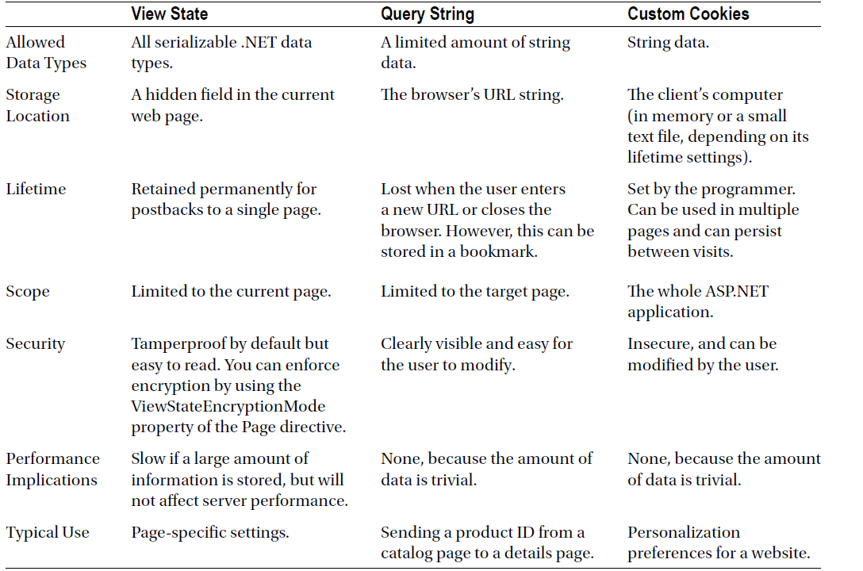

Slide 28
